Slide 1
The Walter H. Crowley School of Leadership at I.S. 5
Kelly Nepogoda, Principal
Expectations for schoolwide safety and wellbeing 2022-2023
Presented to all students in the month of September 2022

Slide 2
Scholars Experts Innovators Leaders
Ms. Koenig Assistant Principal C402 | Ms. McLean Assistant Principal C302 | Mr. Morgan Assistant Principal B301 | Ms. Winkler Assistant Principal D305
Ms. Levan Guidance Counselor C314 | Ms. Etienne Guidance Counselor C302 | Ms. Miller Guidance Counselor B414 | Ms. Murphy Guidance Counselor D208
Ms. Rengel Dean C414 | Mr. Gratereaux Dean C302 | Ms. Jaccard Dean B214 | Mr. Rojas Dean D409

Slide 3

Lanyards & ID's
Lanyards and ID's MUST be worn ALL day.
Please make sure you have your ID with you while walking in the halls, classes, and upon entering the building. You will be asked to show ID upon morning entry.
We will be giving out lanyards to students who have misplaced them. Please be responsible and care for your belongings.

Slide 4


Morning Entry
Please have your lanyard and ID ready for entry at 8:10am
BE ON TIME!! School begins promptly at 8:10am. When Community doors close make sure to enter through the main entrance and receive a late pass.
Breakfast is being served from 7:40am-8:10am. You may enter through the main entrance and directly to the large cafeteria. Once you enter the building you are NOT allowed back outside.
CELL PHONES and ELECTRONICS must be turned OFF and put away once you enter the building.

Slide 5

Hallway & Bathroom Passes
Please make sure that you have an official I.S. 5 hallway pass (yellow pass) when leaving the classroom or walking the halls. It must be filled out completely and signed by your teacher.
Bathroom log book must be signed LEGIBLY with first and last name. Make sure to write the correct time when entering and exiting the bathroom.
Bathrooms are open on the 1st and 3rd floor all day. 2nd floor is open period 1, 2, 3 and 8.

Slide 6
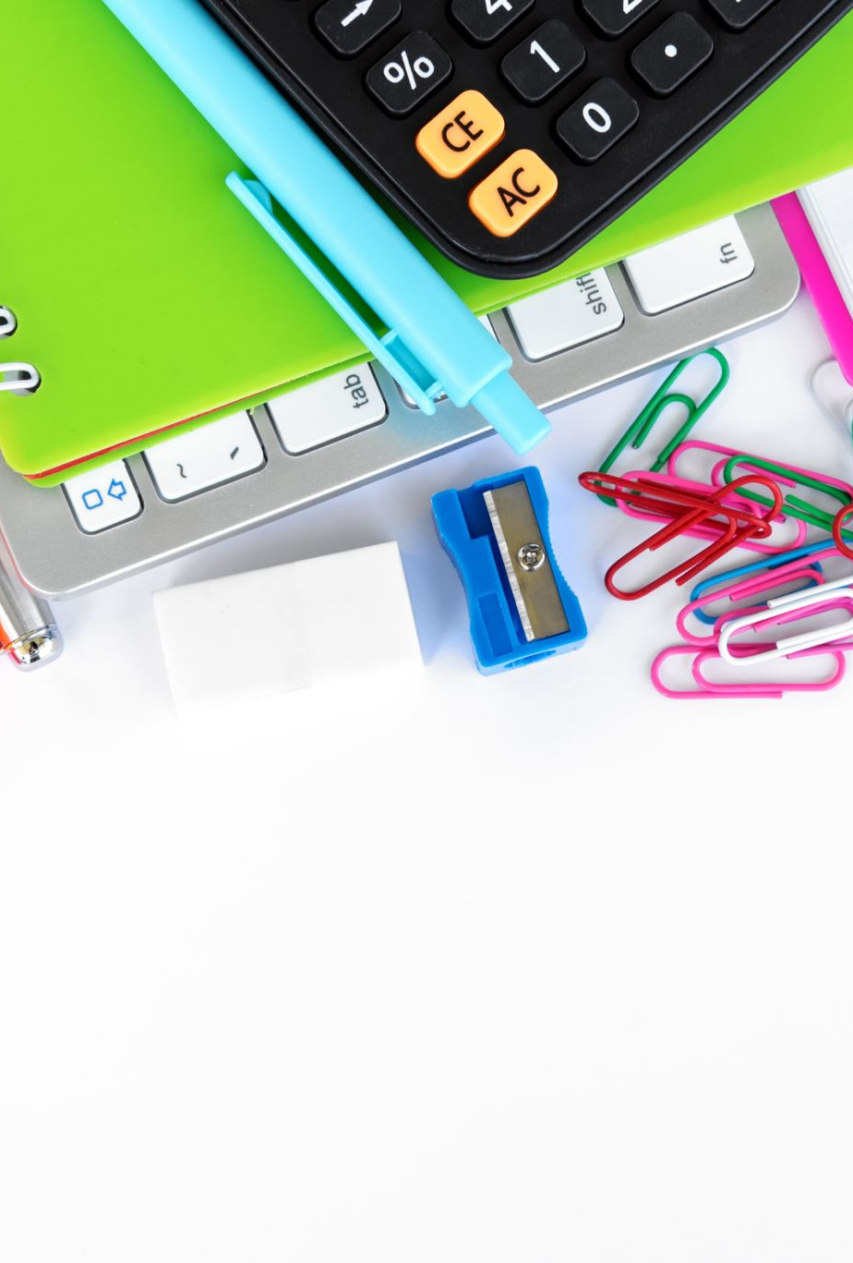
Cell Phone Policy
Once you enter the building your cell phone must be turned off and put away!!
Your phone can and will be confiscated by any school staff member if seen out. Your parent will then be contacted.
Just a reminder, you and your parents have signed a cell phone policy contract outlining the school policy on the use of cell phones.
If your phone is taken away 2 or more times, your parent will have to come and pick it up from school.

Slide 7

Food & Drinks
Breakfast is served from 7:40am – 8:10am. Make sure to clean up and discard of any leftovers.
Water bottles should be in a clear bottle. NO coffee, NO Arizona, NO Gatorade, NO lattes, NO glass bottles. Any drink other than water will be asked to be thrown away.
This Photo by Unknown author is licensed under CC BY-SA.

Slide 8
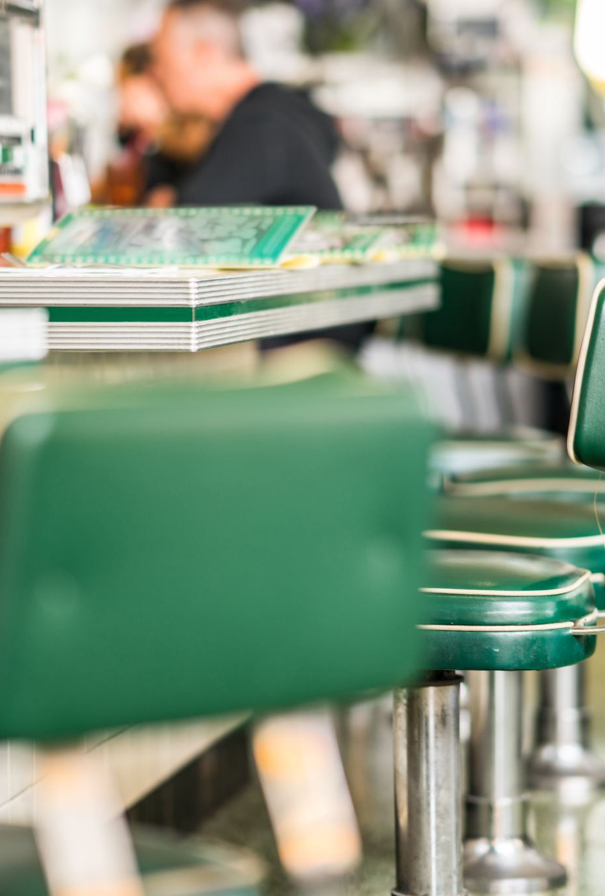
Lunch Protocols
All students must enter the large cafeteria through the B wing
Once you enter settle down and get ready for the countdown
For your safety, there is absolutely NO running in the cafeteria
NO ELECTRONICS in the cafeteria. You may bring a book, cards, board games, coloring books, etc. This is to protect from any damage or accidents.
You must sign out and have a pass to use the bathroom. Wait by the table until a pass returns in order to go.
Make sure to clean up after yourself. Do not leave any garbage on the table or floor. Use a wipe to wipe down your area as well.

Slide 9
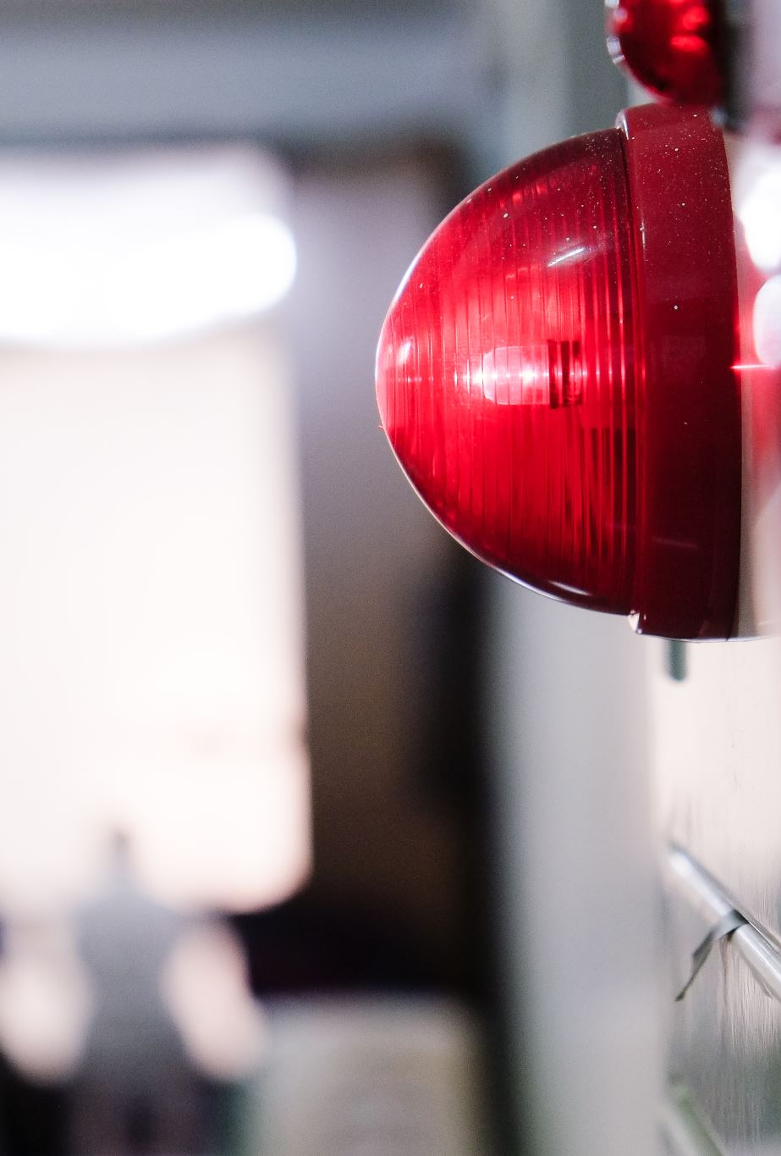
Drills
Fire drill - you must walk down silently through your designated exit. Make sure to follow your teacher and follow directions given by staff. If you are in the bathroom go to the nearest classroom and tell the teacher. Stay with that class. The teacher will let the us know.
Lockdown - During a lockdown, your teacher will lock the door, turn the lights off and instruct you to hide. You MUST be absolutely quiet and out of sight during a lockdown drill. During lunchtime, you are to bend down by your table and wait there. If you are in the auditorium, you will hide behind the curtains and by the doors to the vomitorium.
Shelter In – We continue business as usual inside the building. However, doors are locked and no one enters or exits the building.
Hold - Everyone remains in place until the hold is lifted. There is no movement in the halls. Stay where you are.

Slide 10
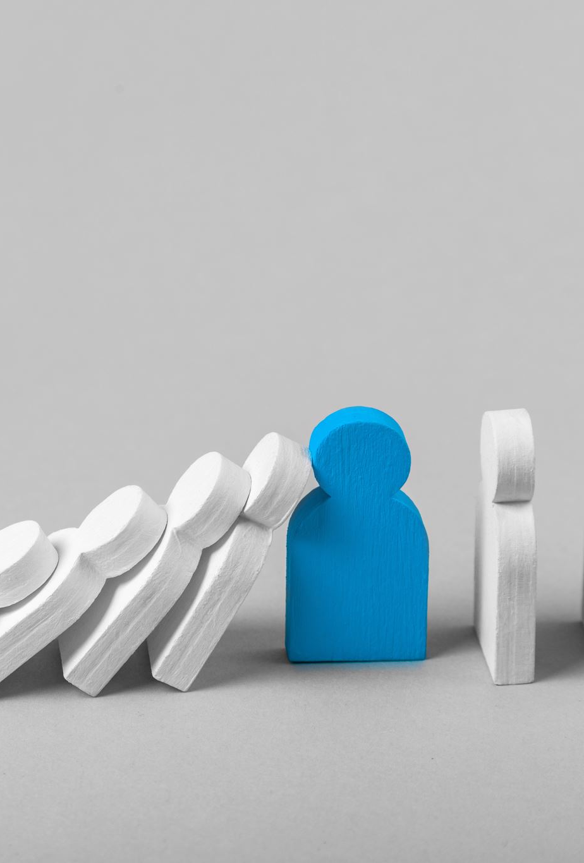
Dismissal
Make sure to exit through your school community doors.
If you are taking the yellow school bus stand on the side by Mr. Morgan.
If you are a walker, please make sure to clear the area as quickly as possible.
When crossing Queens Boulevard, please be aware of cars, lights, and sounds. PAY ATTENTION to the crossing guards and Mr. Rojas.
DO NOT cross during a green light, wait for the walk sign or to be instructed to cross.
If you attend Beacon afterschool, exit your community door and head directly to the schoolyard

Slide 11
NYC DOE Emergency Readiness
Resources for parents and guardians on the nyc doe website
http://Schools.nyc.gov

Slide 12
Questions, concerns, wonderings?
Contact information
I.S. 5 Main Number: 718-205-6788
Kelly Nepogoda, Principal I.S. 5
Kdobson@schools.nyc.gov
Christina Koenig, Assistant Principal of Safety, I.S. 5
Ckoenig2@schools.nyc.gov
Licette Galicia, Parent Coordinator, I.S. 5
Lgalicia@schools.nyc.gov

