Slide 1

Walter H. Crowley, I.S. 5
Kelly Nepogoda, Principal
Community Grade Level Presentations
April 2022

Slide 2
I.S. 5 Community Teams
Community of Scholars Team:
  Christina Koenig, Assistant Principal
  Athena Levan, School Counselor
  Jasmine Rengel, Dean
Community of Experts Team:
  Ebony McLean, Assistant Principal
  Johanne Etienne, School Counselor
  Robert Gratereaux, Dean
Community of Innovators Team:
  William Morgan, Assistant Principal
  Marjorie Miller, School Counselor
  Kathleen Jaccard, Dean
Community of Leaders Team:
  Sheryl Winkler, Assistant Principal
  Jamie Murphy, School Counselor
  Joseph Rojas, Dean

Slide 3
Upon arriving back from April break, all community grade level groups had a special auditorium presentation to reiterate our safety and security practices at I.S. 5
What was discussed with all students?
Protocols for breakfast program
i.s. 5 cell phone policy (CR A413)
Community lanyards
Hallway and bathroom passes
Hats, hoodies and clothing choices
Beverages inside school
attendance

Slide 4
Breakfast – 7:40am – 8:10am
There will no longer grab and go breakfast that you use to get at your community door when you entered the building in the morning.
Breakfast will now be served in the large cafeteria. At 7:40am – 8:10am. You must go through the front of the school and turn immediately to your right to enter the large cafeteria. Please note – make sure to have your health screener completed on paper or completed on your cell phone in order to enter the building.
Please note – once you are in cafeteria for breakfast. ALL CELL PHONE AND ELECTRONIC DEVICES must be turned off and put away.
Finally, once you have entered the cafeteria you cannot leave the cafeteria until the bell rings, and you are dismissed to go to homeroom.

Slide 5
Cell Phones
All Students – once you have entered the school building, your cell phone must be turned off and put away.
If your phone is confiscated (taken away) from you, your parent will be contacted and at the end of the school day you can retrieve your cell phone from the main office.
If this happens more than twice (two times), you parent will be contacted and only they can retrieve your cell phone. It will not be given back to you, only to your parent.
Just a reminder, you and parents had signed a cell phone contract at the beginning of the school year, regarding our school cell phone policy.

Slide 6
School Community Lanyards
As you are all aware, your community teams have been asking you at the door to show your lanyards and IDs.
For security and safety reasons, it is mandatory that all students wear their community lanyard attached to their school identification card.
The lanyards for communities are color coded.
During this week, teams will be going around to all classes to make sure all students have their community lanyards and school identification.
Lanyards MUST be worn ALL day.
If you need a replacement identification card, we will reissue and document you have received a new one.

Slide 7
Hallway and Bathroom Passes
Please make sure when you go to the bathroom or to another classroom that you have an official I.S. 5 hallway pass. It must be filled out completely and signed by your teacher.
We made sure that ALL teachers have passes in the classroom.

Slide 8
Hats, Hoodies and Clothing Choices
For reasons of security and safety, once you have entered the school building, you must take off your hoodie or hat.
You cannot wear crocs, slippers, or sliders.
You cannot wear tanks, crop tops, halter tops or blouses with spaghetti straps.

Slide 9
Attendance
It is very important for you attend school.
Please note, when you are absent. A call is made to your home automatically.
If you are running late, please make sure to get a late pass.

Slide 10
What is “GRP” & “Shelter-In”
NYC DOE Protocols for safety

Slide 11
General Response Protocol – “Shelter-In”
A Shelter- In would be used in different conditions that may include:
•Dangerous weather conditions.
•Police activity in the immediate vicinity of the school.
•Other hazardous/ dangerous conditions outside of the building.
A Shelter-In is only lifted by NYPD.
Families and guardians are notified by the school in collaboration with NYC DOE central as well as NYPD.

Slide 12
General Response Protocol – “Shelter-In”
Teachers will:
  Increase situational awareness.
  Conduct business as usual. Follow all announced directions and remember that the Shelter- In directive remains in effect until they hear the announcement “The Shelter-In has been lifted”.
  Remember that BRT members, floor wardens and School Safety Agents will ensure that all perimeter doors and floors posts are secured and monitored until the Shelter- In has ended.
Students will remember that:
  They will be secured inside of the building.
  Classes will continue as usual. However, once the exit doors have been secured, no one will be permitted to enter or leave the building until the Shelter- In has ended.
  They must listen to all announcements as directions may change during each incident.

Slide 13
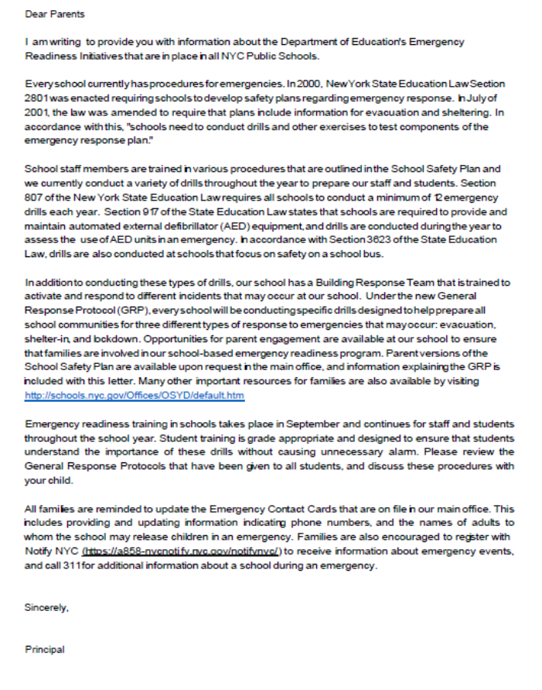
Annual Letter for General Response Protocol
Every year, parents and guardians receive a letter regarding General Response Protocol
To review protocols and information, please visit schools.nyc.gov and see “Parent Guide to School Safety and Emergency Preparedness”
https://www.schools.nyc.gov/school-life/safe-schools/school-safety/parent-guide-to-school-safety-and-emergency-preparedness

Slide 14
Welcoming Parent & Guardian Questions
Madelene chan, superintendent
Kelly nepogoda, i.s. 5 principal
i.s. 5 administrative team

